Slide 1

Relational Design Critque
Louis Davidson – drsql.org

Slide 2
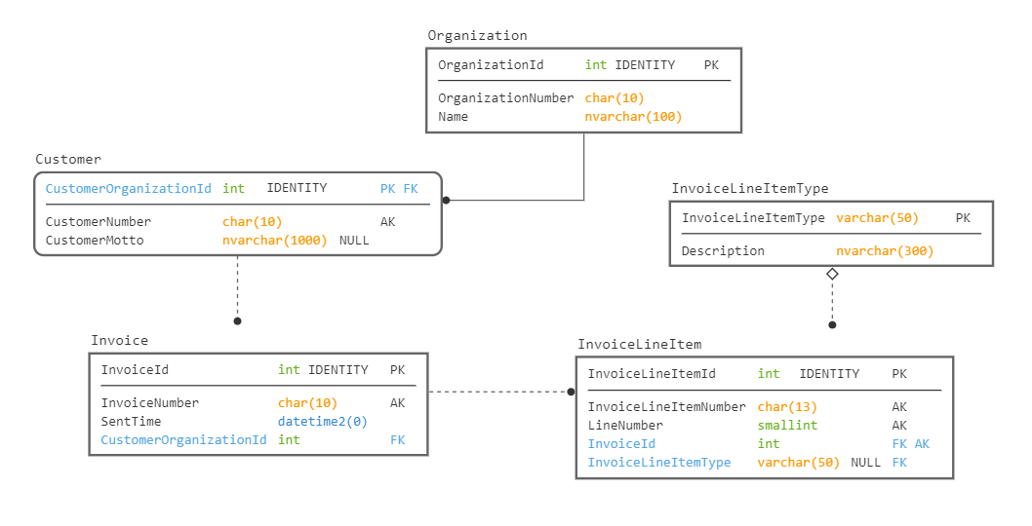
Test Viewing

Slide 3
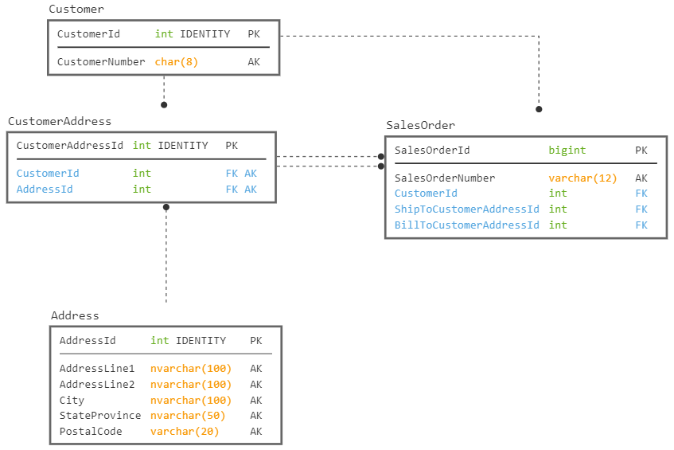
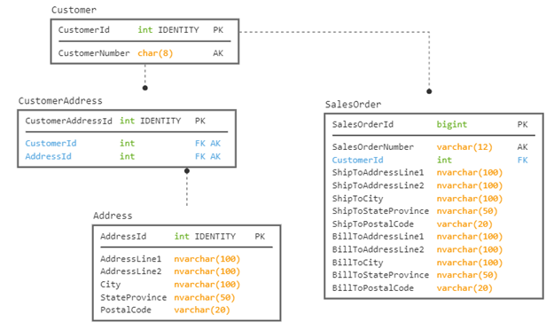
Test View 2

Slide 4


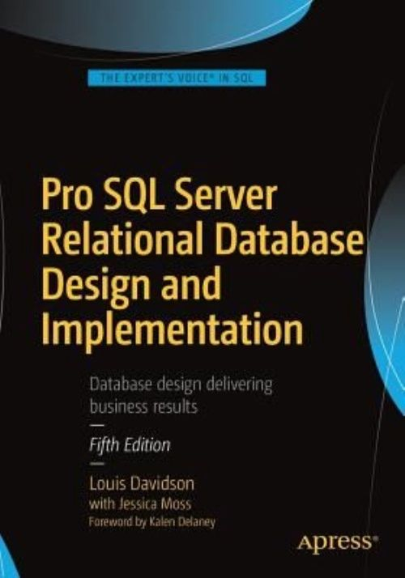
Who am I?
Been in IT for over 20 years
Microsoft SQL MVP For 15 Cycles
Corporate Data Architect
Written five books on database design
Ok, so they were all versions of the same book. They at least had slightly different titles each time
They cover some of the same material…in a bit more depth than I can manage today!

Slide 5

Brief Contact Info: DRSQL
Louis Davidson - louis@drsql.org
Website – http://drsql.org ← Get slides here
Twitter – http://twitter.com/drsql
Blog on Simple-Talk https://www.red-gate.com/simple-talk/author/louis-davidson/
Notes:
[twitter] Slides will be on drsql.org in the presentations area for this and the keynote as soon as I can get them out there. @rmtechtrifecta [/twitter]

Slide 6

Warning: This session is very interactive
If no one participates, it will last about 15 minutes
If everyone participates, it should be a lot of fun
This Photo by Unknown Author is licensed under CC BY-SA-NC

Slide 7
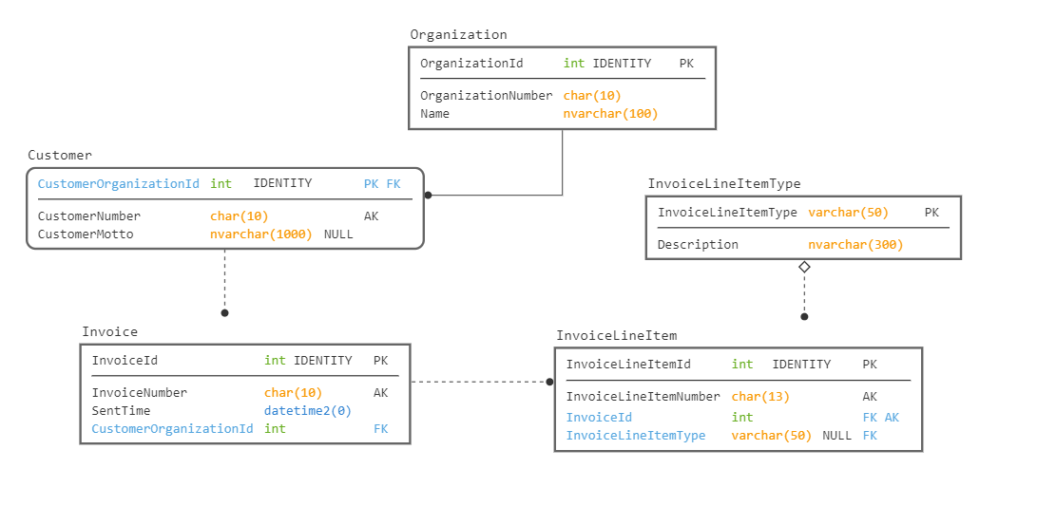
Data Model Graphical Language Basics
Primary Key
Solid Line Means FK is Identifying (Means PK of Parent in PK of Child)
Dashed line is non-identifying
AK is an UNIQUE CONSTRAINT. Cannot tell from diagram if there are more than one AK
Columns NOT NULL unless specified.
Dot on end represents child table in relationship (Foreign Key is in Child table)
Diamond indicates this is an optional relationship (the FK value can be NULL)
Models drawn with: https://sqldbm.com/

Slide 8
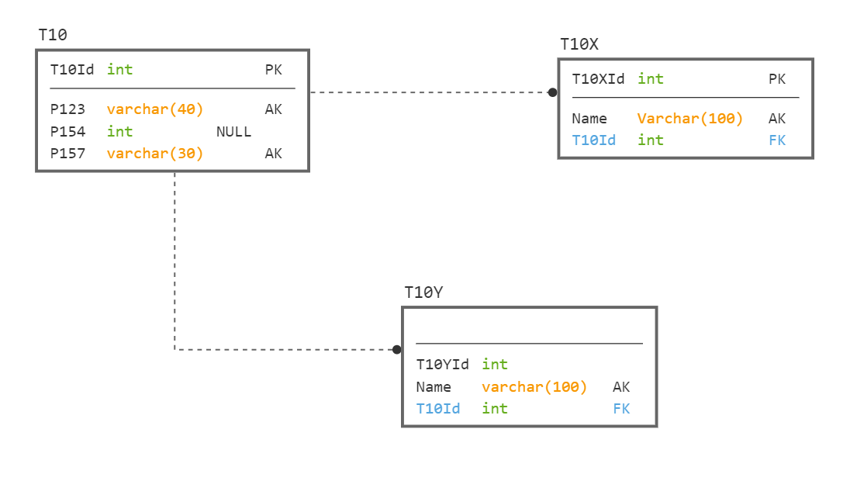
#1

Slide 9
Only one thing is for certain wrong…
Every Table Needs A Primary Key

Slide 10


Don’t Judge A Database Only By Its Model
Judge it by how its model compares to the requirements
Every data model could be for a real database
Companies do really weird stuff
Realistically though, this is USUALLY wrong
Note: last “trick” requirements question. In the future, model problems will be based on normal issues.

Slide 11
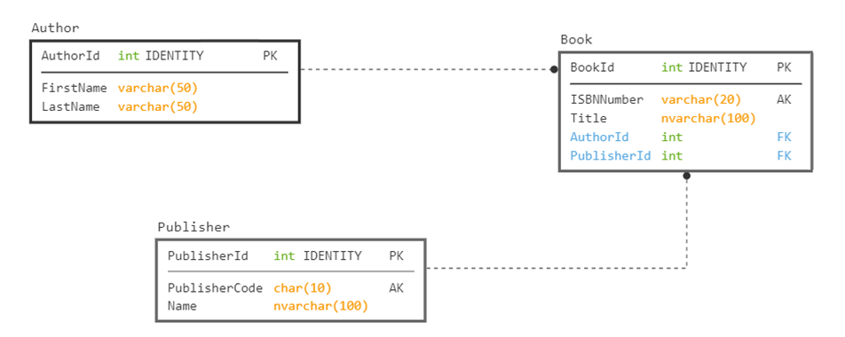
#2 Requirement: Store information about books and authors

Slide 12
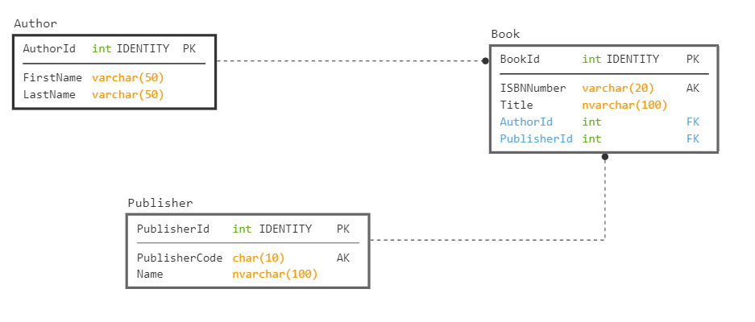
In 2017 and earlier: Use nvarchar
In 2019 on: Use nvarchar or varchar with UTF-8 Collation

Slide 13
Needs an alternate key, since the AuthorId is an identity value. What if we have three authors with same first and last name?

Slide 14
Books may have more than one Author.
Also, first name should likely be nullable

Slide 15
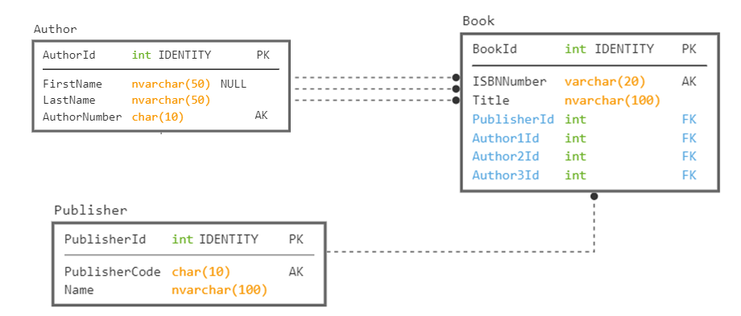
#2.1 Requirement: Store information about books and authors

Slide 16
Books may have more than three Authors. (I worked on a book with 50)
This also makes a very rigid implementation.
Another issue… These are not nullable columns, so we must have 3 authors

Slide 17
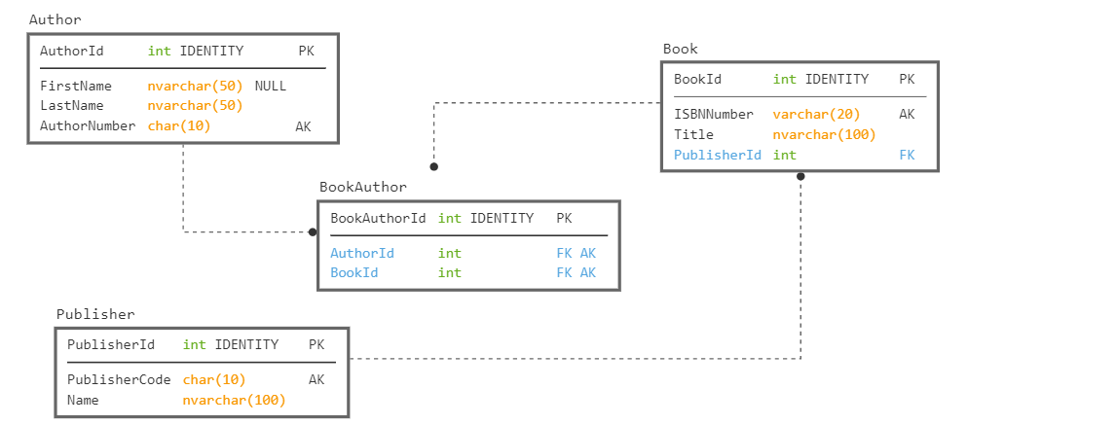

Slide 18
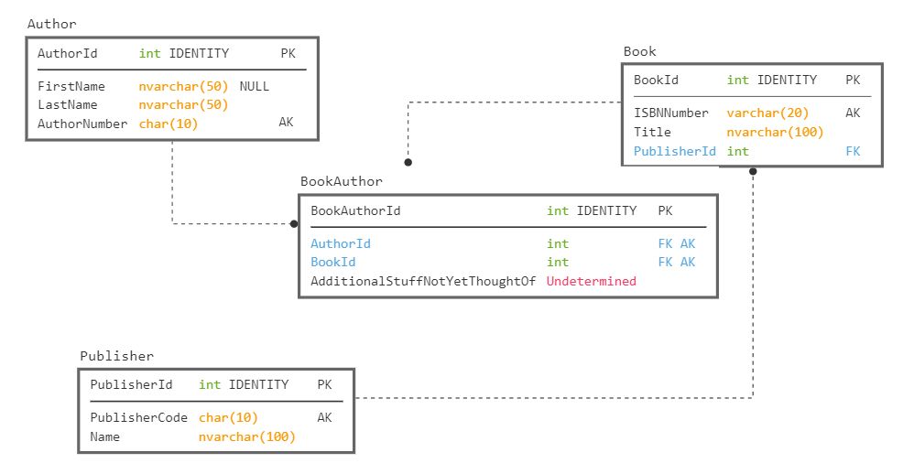
Lets us add details where they are needed too

Slide 19

Attribute Cardinality
When building your databases, make sure to consider the cardinality of each attribute
Will the user need to store more than one value?
Work to make sure that the design won’t bend past the limits you expect
Test with the most wild examples possible
What about a book with 100 authors?
Establish a “this is the max cardinality” rule if necessary
It is easier to deal with these problems at design time than once you have 3.5 million (or even billion) rows in your book table.

Slide 20
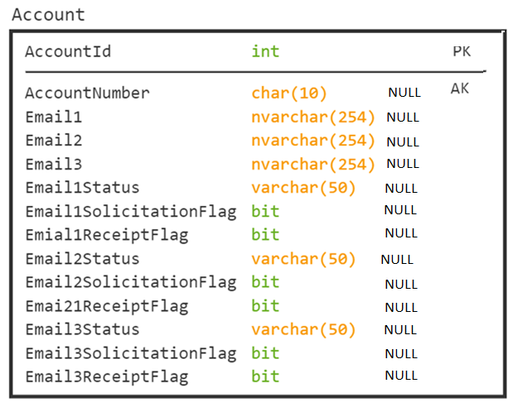
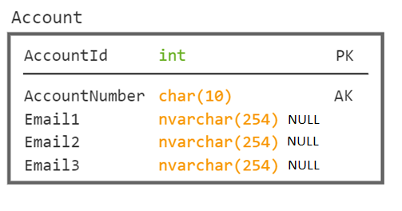
Real, But Sad Example
Louis doesn’t spell very well. But this is critique fodder!
(The poor spelling is not from a real DB!)
Bonus Point Time:
Any other problems you see?

Slide 21
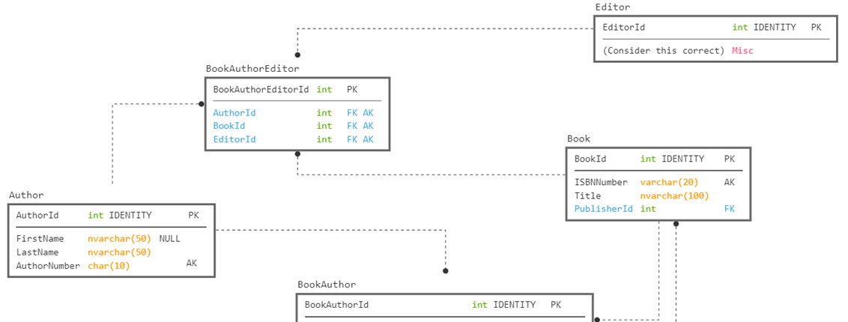
#3 Requirements: Define the authors and editors of a book

Slide 22
Book, editor, author Note: consider the values keys to other tables
Table IS in definitely 3NF, since it only has key attributes
Table is in not in 4NF if this represents:
Book “Design” has authors Louis and Jeff and Editor Tony
Book “Golf” has authors Louis and Fred and Editors Steve and Tony
Table is in 5NF if this represents
For book “Design”, Editor Tony edits Louis’ work and Leroy edits Jeff’s work
For book “Golf”, Editor Steve edits Louis’ work, and Tony edits Fred’s work.
Book Author Editor
=================== =================== ===============
Design Louis Tony
Design Jeff Leroy
Golf Louis Steve
Golf Fred Tony

Slide 23

Document Complex Keys
When you have > 2 independent attributes in a key, consider the actual meaning
Make sure that all of the non-key columns actually refer to the entire key
If all attributes are not dependent on each other, then you may have issues

Slide 24
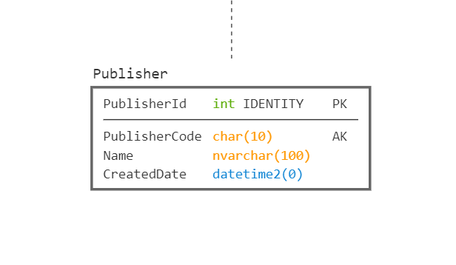
#4 Requirement: Determine When A Publisher Started Working With Your Company
ALTER TABLE Publisher ADD CreatedDate datetime2(0) DEFAULT (SYSDATETIME());

Slide 25

Rarely Rely on Defaulted System Values
The time when a row is created is rarely the time you care about
Anytime a customer really cares about a time value to seconds, or partial seconds, the time it takes to save the data matters
Real-ish example:
User watches TV program
Calls in take 30 seconds to dial, 22 to get an answer
Then talks to a person on the phone for 10 minutes
Decides to make a purchase
It takes 2.1 minutes to take the order and then 10.4 minutes to work through the verification system
The order is created over 22 minutes after they watched the program
Which point in time matters? Which time can you actually capture?

Slide 26
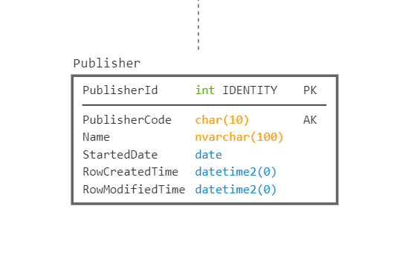
No default, make the user pick the time (defaulting the value in the UI to the current time DOES make sense, but data could go through layers of objects/async processes to get to the database)
Tells you when the row itself was added to the database
Consider using TimeZone Offset Aware Datatype if you have any likelihood of having servers in multiple time zones (we have all time in Eastern Time)
Use the datatype with the most realistic granularity. You don’t want to say the Publisher started at ‘June 12, 1989 10:00:32.1213423’ unless it is actually important to the customer

Slide 27
#5 Requirement: Capture the address of a customer for an order.
← This or This →

Slide 28
Do each of these have the same meaning?
#5 Requirement: Capture the address of a customer for an order.
← This or This →

Slide 29
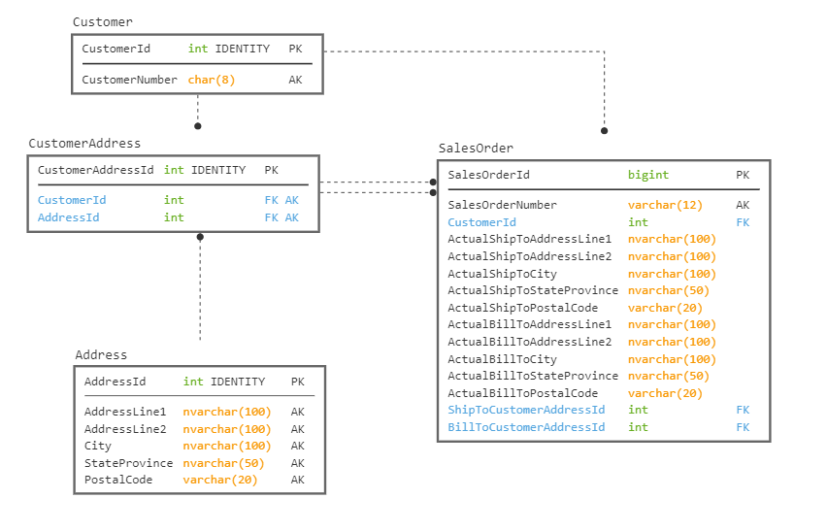
I lied. Another “trick” questions. Answer: “At least the copies It depends…perhaps both”
Maybe adding type would allow us to not have the key values on the address?
Copied version corresponds to “as of shipping” address. Never changes.
Should actual ship to columns allow NULL values
(Or be in its own table?)
Key version corresponds to “current” address. Meaning changes as customer changes their address

Slide 30
Practice reading databases
Database structures read like books
The better the database, the easier to follow the story
Subtle differences come from differences large and small

Slide 31
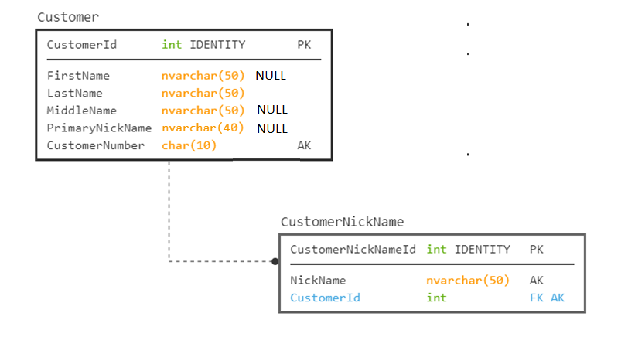
#6
Requirement: Need to store a customer and their nicknames. 99.9999% of our customers have only 1 nickname.

Slide 32
#6
Requirement: Need to store a customer and their nicknames. 99.9999% of our customers have only 1 nickname.
Now… Search for a customer with the NickName of ‘Fred’
You have to query two tables
Lets us add details where they are needed too
Another Common Issue:
Different datatypes on columns that hold the same thing

Slide 33
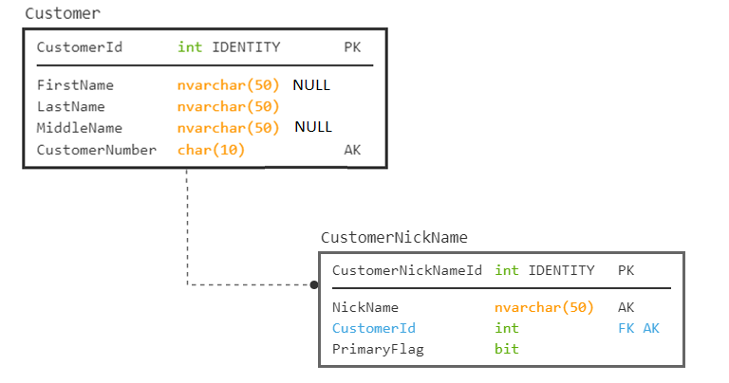
Now… Search for a customer with the NickName of ‘Fred’
You have to query just one table

Slide 34
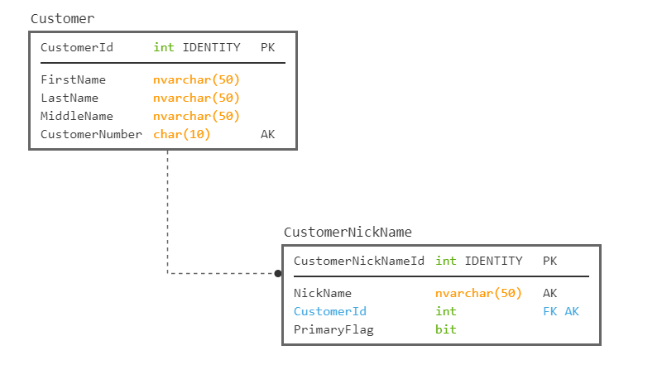
#6.1
Requirement: Build a UI to work with NickNames. Would this work?
First Name Last Name
Louis
Davidson
NickNames
Lewis; Dr SQL; Dr Squirrel; Louman; SQL Guy; Hey You!
As long as:
the UI takes the normalized data and displays it in this manner,
Saves it back to the DB correctly when saved
Why not?

Slide 35
Database Designs must cater to the 100% case
Otherwise, you end up with the atypical data not being able to be stored.
For this nickname case:
Tailor the UI to the user’s needs, put one nickname on the UI or an indicator that they have more than one
Or make it clear that the first in the text list is primary
The database should have the extra table for the nickname
When you search for a value, it should be able to be done in a single query without parsing data

Slide 36
This is what we are trying to avoid…
Dear Lewis; Dr SQL; Dr Squirrel; Louman; SQL Guy; Hey You!
We hope this letter finds you well, I hope that you, Lewis; Dr SQL; Dr Squirrel; Louman; SQL Guy; Hey You! will be able to attend our conference.
Sincerely,
Clearly Not A Person Who Pays Attention

Slide 37
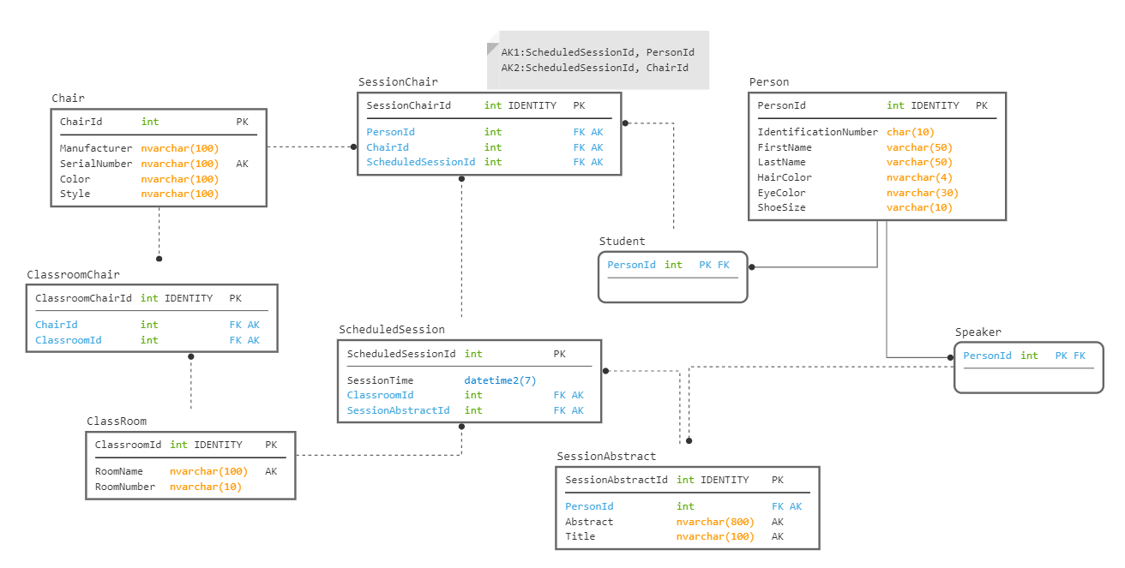
#7
Requirement: Model the classroom we would have been in had the world not turned upside down

Slide 38
Well Designed, Normalized Design Should Match Requirements
Academically, it feels like you should break down every value into constituent parts.
Yet, if the customer doesn’t care, won’t use the details, it is not a good design
Your job is to meet the customer’s requirements and cover their typical usage of data

Slide 39
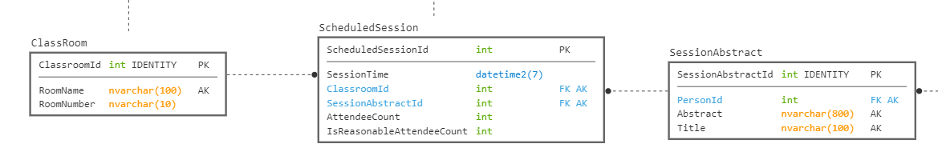
#8 Requirement: Capture the count of people in a session

Slide 40
Naming Standards Make A Big Difference
Avoid overly specific prefixes/suffixes
Follow a standard format for names
An example that I have seen documented in various places (often attributed to ISO 11179) is to have names that include something along the following:
RoleName – Optional for when you need to explain the purpose of the attribute
Attribute – The primary purpose of the column being named. Optionally can be omitted, meaning it refers to the entity
Classword – a suffix that identifies the usage of the column, in non-implementation specific terms
Scale – Optional to tell the user what the scale of the data is, like minutes, seconds, dollars, euros, etc
RoleName_Attribute_Classword_Scale

Slide 41
Column Naming Examples
Name - a textual string that names the row value, but whether or not it is a varchar(30) or nvarchar(128) is immaterial (prefix is implied. Example Company.Name)
UserName - a more specific use of the name classword that indicates it isn’t a generic usage
AdminstratorUserName – A user name, but specifically for the admin user.
PledgeAmount - an amount of money (using a numeric(12,2), or money, or any sort of types)
PledgeAmountEuros - an amount of money (using a numeric(12,2), or money, or any sort of types), but with an atypical scale
TickerCode - a short textual string used to identify a ticker row
EndDate - the date when something ends. Does not include a time part
SaveTime - is the point in time when the row was saved
MailIsHereFlag – indicates that the mail is here. Could be a bit, ‘yes’ or ‘no’, and could be null, because we aren’t sure if the mail is here or not.

Slide 42
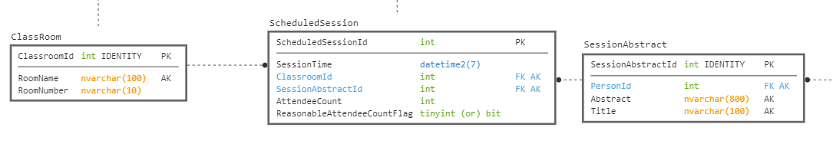

Slide 43
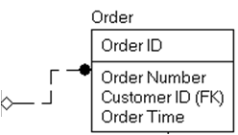
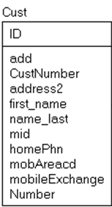
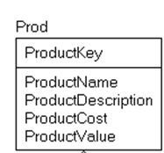
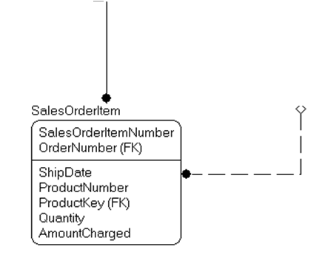
The best of intentions
One Naming Standard: Even if it stinks

Slide 44
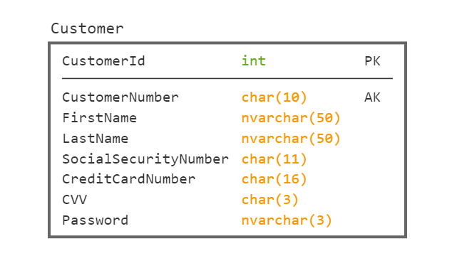
#9 Requirement: Capture Personally Identifiable Data About A Customer

Slide 45
Oh so many things wrong
First:
Only store Personally Identifiable data when you must
For credit card numbers, try to use a bank that will keep the data safe and give you a token that only you can reference
Second:
Anything you must store: encrypt
Make sure the encryption is strong
Make sure the key to decrypt isn’t available too easily
And a 3 character password limit is horrible enough even if you encrypted it

Slide 46
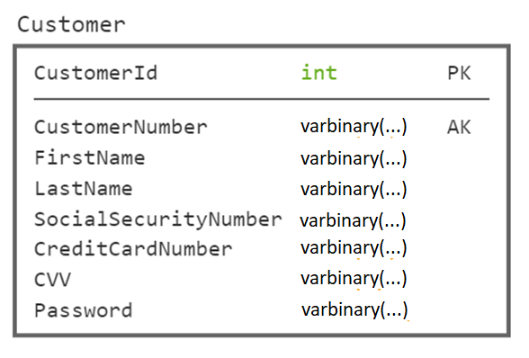
Question just how much to encrypt.
First and Last Name?
CustomerNumber?’
You have to query two tables
#9 Requirement: Capture Personally Identifiable Data About A Customer
Should these allow NULL values?
Never store values you should not ever store.

Slide 47
#10 Question: What is this?
CREATE TABLE Blob (
BlobValue nvarchar(max), MakeUniqueValue int NOT NULL UNIQUE DEFAULT (1), CHECK (MakeUniqueValue = 1) );
Answer: The most ______________ database possible
denormalized

Slide 48
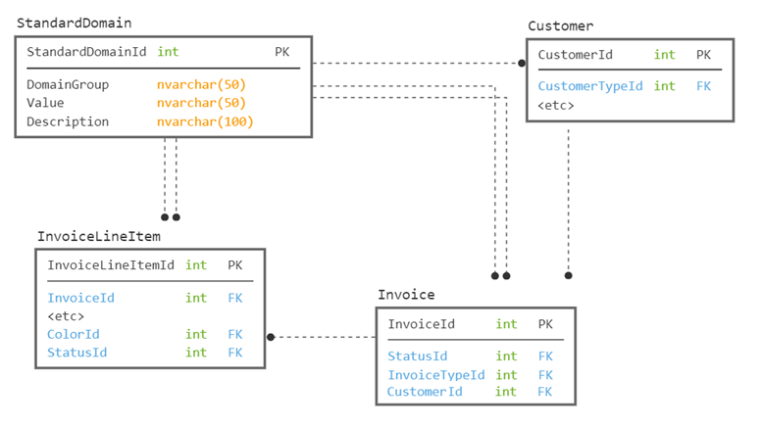
#11 Requirement: Store domain data about one or more tables

Slide 49
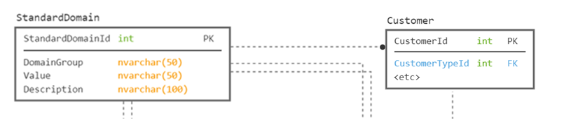
Generic Structures (not a favorite)
Consider this snippet.
You would need groups and values for different usages:
DomainGroup=CustomerType; Value=Individual; Description=Etc
DomainGroup=CustomerType; Value=Organization; Description=Etc
Now… How do you validate that Customer.CustomerId has only CustomerType values, since you will also have Color, InvoiceStatus, etc

Slide 50
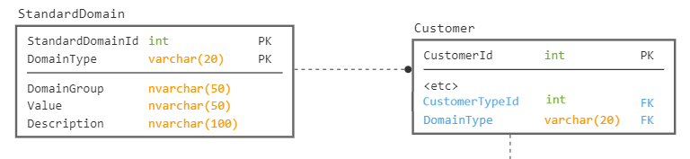
Generic Structures (not a favorite)
Now… How do you validate that Customer.CustomerId has only CustomerType values, since you will also have Color, InvoiceStatus, etc
A variant would make the type a part of the key, and hence FK
Then you can validate with a check constraint…
Still… Uck

Slide 51
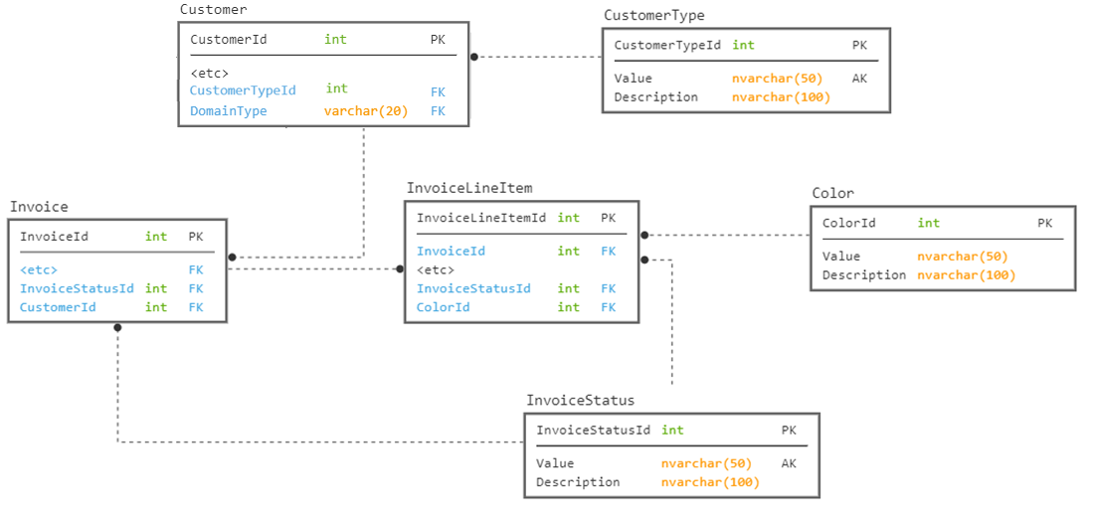

Slide 52
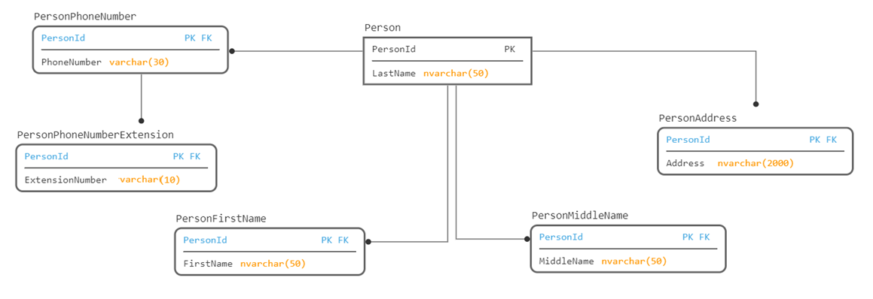
#12
Requirement: Store information about a person, efficiently

Slide 53
Avoiding NULL values is a good goal… but
Don’t do it by making your design bizzaroland complicated
To use the data, you would just have to do outer joins, and missing data would be ….. NULL
Note: this was taken from a friend of mine’s actual experiences

Slide 54
What about very structured values
Example: phone numbers, address, credit card number, social security number
Should only be broken down to the way the user will use it
Just a blob of text may be adequate for your usage if:
You rarely search by area code, or exchange (particularly to update an area code)
You need to store many country’s phone number format (breaking the table into 1 table per format would make it very unusable)

Slide 55
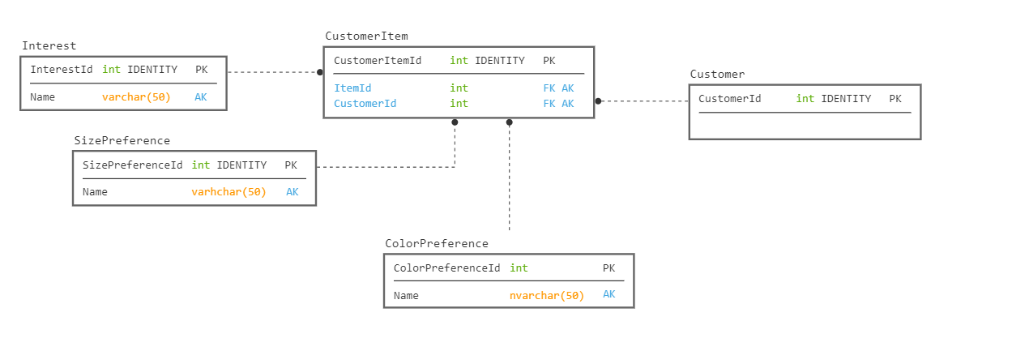
#13
Requirement: Store various multi-valued attributes about a customer.

Slide 56
This is a Simulated Graph Structure
SQL Server 2017 and later have Graph objects (Node and Edge) as first class tables.
The model will look very similar, but internally they are managing the relationships
Special syntax is available for working with graphs
Building like this will make you crazy
It is hard to tell where the relationship comes from without more data
Make a table per many-to-many relationship with a table if building relationally
You still have to join each table individually

Slide 57
Questions? Contact info.. Thank you!
Louis Davidson - louis@drsql.org
Website – http://drsql.org ← Get slides here
Twitter – http://twitter.com/drsql
Blog on Simple-Talk https://www.red-gate.com/simple-talk/author/louis-davidson/
Notes:
[twitter] Slides will be on drsql.org in the presentations area for this and the keynote as soon as I can get them out there. @rmtechtrifecta [/twitter]

